Slide 1

Sprocket Central Pty Ltd
Data analytics approach
[Division Name] - [Engagement Manager], [Ved Thakur], [Junior Consultant]

Slide 2
Agenda
Work done till now
Presenting Dashboards
Trends based on dashboards and customer segment to target
Suggested marketing and growth strategy
Additional external datasets required

Slide 3
Work done till now
Cleaning of data for data quality - Initially all the data was cleaned. It was checked for any blank values. The validity and the accuracy of the data points was also verified. Further the data was also checked for uniqueness and duplicate values. All the points were mentioned in the Task 1 email sent to the client.
Data exploration - The data was then converted into format for better understanding. Like instance, the DOB column was converted into age column. Fields like profit were created for comparing the features of a customer with the profit he made to the gain. By this data we could predict the behaviour of new customers based on their features on whether these customers are likeable to buy a bike and make profit to the company.
Modelling - Several models were created for the evaluation of the customer segment to target. Once such model was the RFM model which was created to calculate the recency, frequency and monetary value score. Based on this score, several customer segments were created and based on the data provided in the new customer sheet, the prospect customers who would bring profit to the company were identified.
Data interpretation - Graphs like column chart, pie chart were created to better understand the data given. Several pivot tables were also created and graphs based on pivot tables eased the understanding of the data provided.

Slide 4
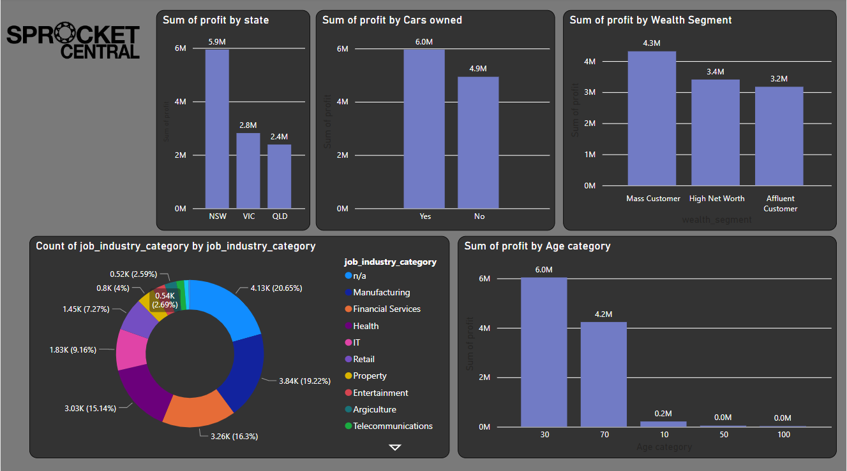
Dashboards

Slide 5
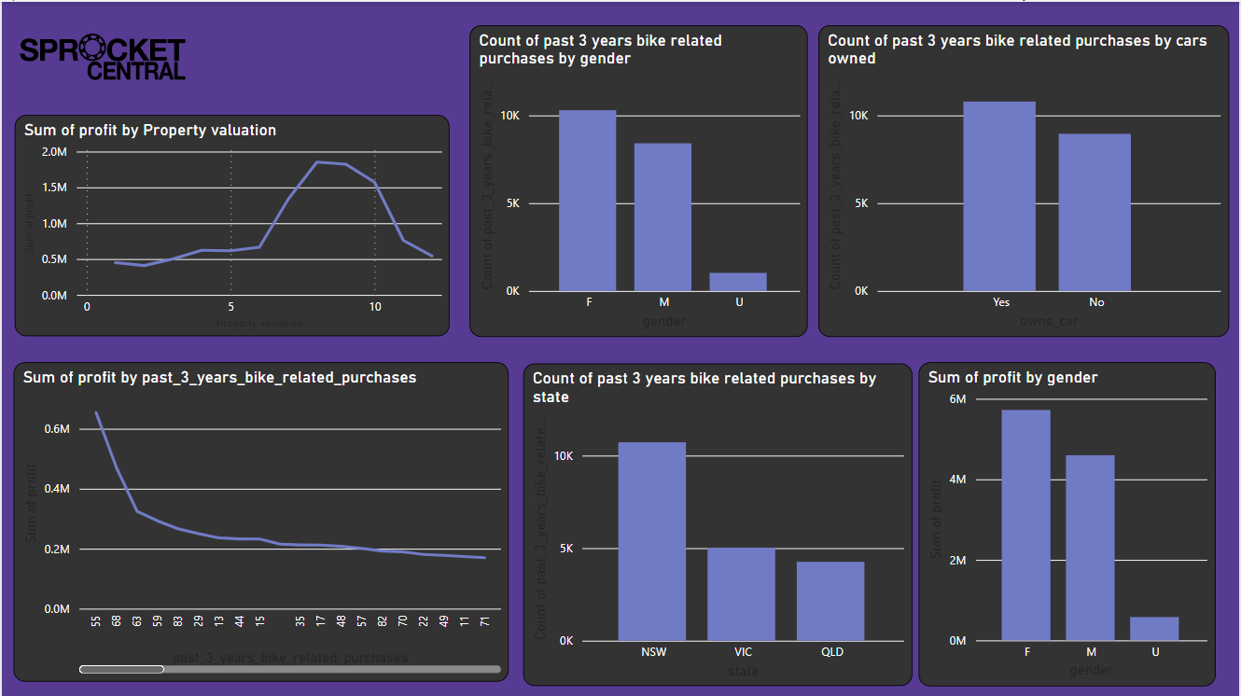
Dashboards

Slide 6
Trends from the data analysed by using Dashboards
New South Wales state people have made more profit to the company than VIC and QLD states.
Mass customer is more likely to buy a bike than Affluent and High Net Worth customers.
Adults having age in the range 20-30 are more probable to buy a bike than any other age group. The next age group more likely to buy a bike would be in the range 60-70 according to data.
Adults belonging to Manufacturing, Financial Services and Heath are more prone to get a bike than any other job sectors
People owning a car are more likely to buy a bike.
Females are more probable to buy bikes than males.
People buying a bike in the past 3 years are less likely to buy a bike again.
People living in the are having valuation between 8-9 are more likely to buy a bike

Slide 7
Customer Segment to Target
Females must be targeted more in comparison to males.
The people belonging to the state of NSW must be targeted more than VIC and QLD people.
Mass customer should be approached as he/she is more likely to get a bike
People belonging to the age groups 20-30 and 60-70 must be targeted more.
People working in the fields of manufacturing, financial services and health should be approached.
People living in places with valuation of around 8-9 is more likely to buy a bike and must be targeted.
Overall: A female living in the state of NSW with a place valuation of 8-9 and has a age group of 20-30 working in the field of Manufacturing and is a mass customer should be most targeted as she is the most likely to buy a bike.

Slide 8
Marketing Strategy and Growth
The marketing strategy should be more health focussed as we see that people from 20-30 and 60-70 being health conscious are more likely to buy a bike.
Also the brand should focus on making a different bike segment for female only as they are the most targeted customers and them getting a cycle suited specifically to cater to their needs would be the best.
The marketing banners and posters should be more done in the New South Wales state as the demand is more in that state.
A different set of high quality bikes can be made available for high property valuation between 8-9 because they are more likely to buy a bike.

Slide 9
Additional datasets required for better analysis
Data of some basic health issues faced by consumers would be helpful as it would enable us to target consumers based on their health issues.
Data of consumers on the distance from their job could help us in pitching the customers regarding using bike to drive to work.
A special segment of bicycles dedicated to mountain bikes can be also pitched if we had the data regarding it.
Data regarding gyms, health centres, mental health centres could have been helpful as our target customers are more likely to visit these places.

Slide 10
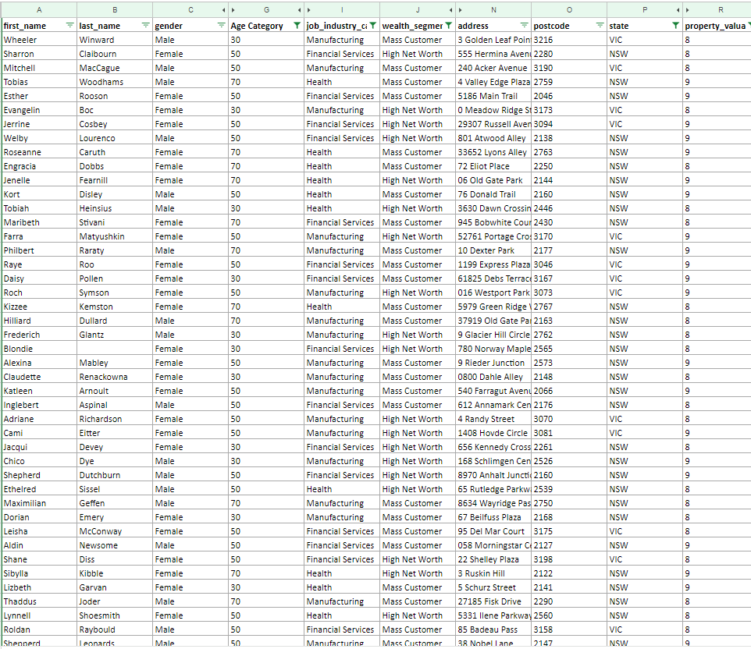
Target List of New Customers
The list can be found at: https://docs.google.com/spreadsheets/d/1yh0VMSCnIq3mbfKTyJsfSkD7TsmiQeQtbhLO8e_cwjA/edit?usp=sharing
A screenshot of the list is attached below. It contains name of top 57 customers which should be targetted and are more likely to buy a bike

Slide 11
References
All the data and dashboards are present at: https://github.com/vedthakur5/KPMG_virtual_internship

Slide 12
Thank You

